Slide 1
Back to equations of geometric transformations

Slide 11
Image of a Point
Homogeneous coordinates of a 3-D point
Homogeneous coordinates of its 2-D image
Projection of a 3-D point to an image plane
P

Slide 13
Properties of P: the projective camera
P is a general 3X4 matrix of rank 3. If it has rank less than 3 then the projection is line or point, not the whole plane.
C is the camera center if and only if PC=0. Indeed, if PC=0, consider the line containing C and any point A in 3-space. Points on this line are: X(k)=kA+(1-k)C. Mapping any such point with P we get: PX=kPA. All points on the line map to PA.

Slide 14
2D homography (projective transformation)
Definition:
Line preserving
A 2D homography is an invertible mapping h from P² to itself such that three points x₁,x₂,x₃ lie on the same line if and only if h(x₁),h(x₂),h(x₃) do.
Theorem:
A mapping h: P²→P² is a homography if and only if there exist a non‐singular 3x3 matrix H such that for any point in P² represented by a vector x it is true that h(x)=Hx
Definition: Homography
⎛ x'₁ ⎞
^{h}12 ^{h}13 ⎤⎛ ^{x}1 ⎞
22
3 31 ^{h}32 33 3
⎡^{h}11
⎥⎜ _{x} ⎟
⎜ ⎟ ⎢
x' = h h
⎜ 2 ⎟
⎢
h
⎥
⎜ 2 ⎟
or
x'= H x
8DOF
⎜ ⎟
21
23
⎜ ⎟
x'
⎢
h
⎥
h x
⎝ ⎠ ⎣ ⎦⎝ ⎠
Homography=projective transformation=projectivity=collineation
14

Slide 15
General homography
Note: homographies are not restricted to P²
General definition:
A homography is a non‐singular, line preserving, projective mapping h: P^{n} → P^{n}.
It is represented by a square (n + 1)‐dim matrix
with (n + 1)²‐1 DOF
Now back to the 2D case…
Mapping between planes
15

Slide 16
Homographies in Computer vision
Rotating/translating camera, planar world
H
H
H
⎛ X ⎞
(x, y,1) = x ∝ PX
⎜ ⎟
T
= H ⎜Y ⎟
⎜₁ ⎟
⎝ ⎠
What happens to the P‐matrix, if Z is assumed zero?
10

Slide 17
Homographies in Computer vision
Rotating camera, arbitrary world
⎛ X ⎞
⎜ ⎟
Y
(x, y,1)^{T} = x ∝ PX = K (r r r t )
⎜ ⎟
∝ KRK ⁻¹ x' = Hx'
1 2 3
⎜ _{Z} ⎟
⎜ ⎟
1
⎝ ⎠
What happens to the P‐matrix, if t is assumed zero?

Slide 18
p’
p
To unwarp (rectify) an image
solve for homography H given p and p’
solve equations of the form: wp’ = Hp
linear in unknowns: w and coefficients of H
H is defined up to an arbitrary scale factor
how many points are necessary to solve for H?

Slide 19
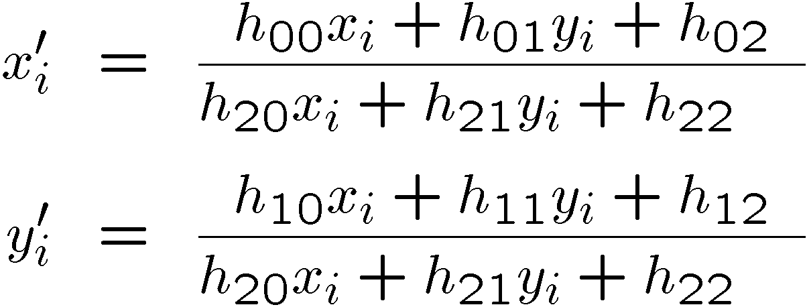
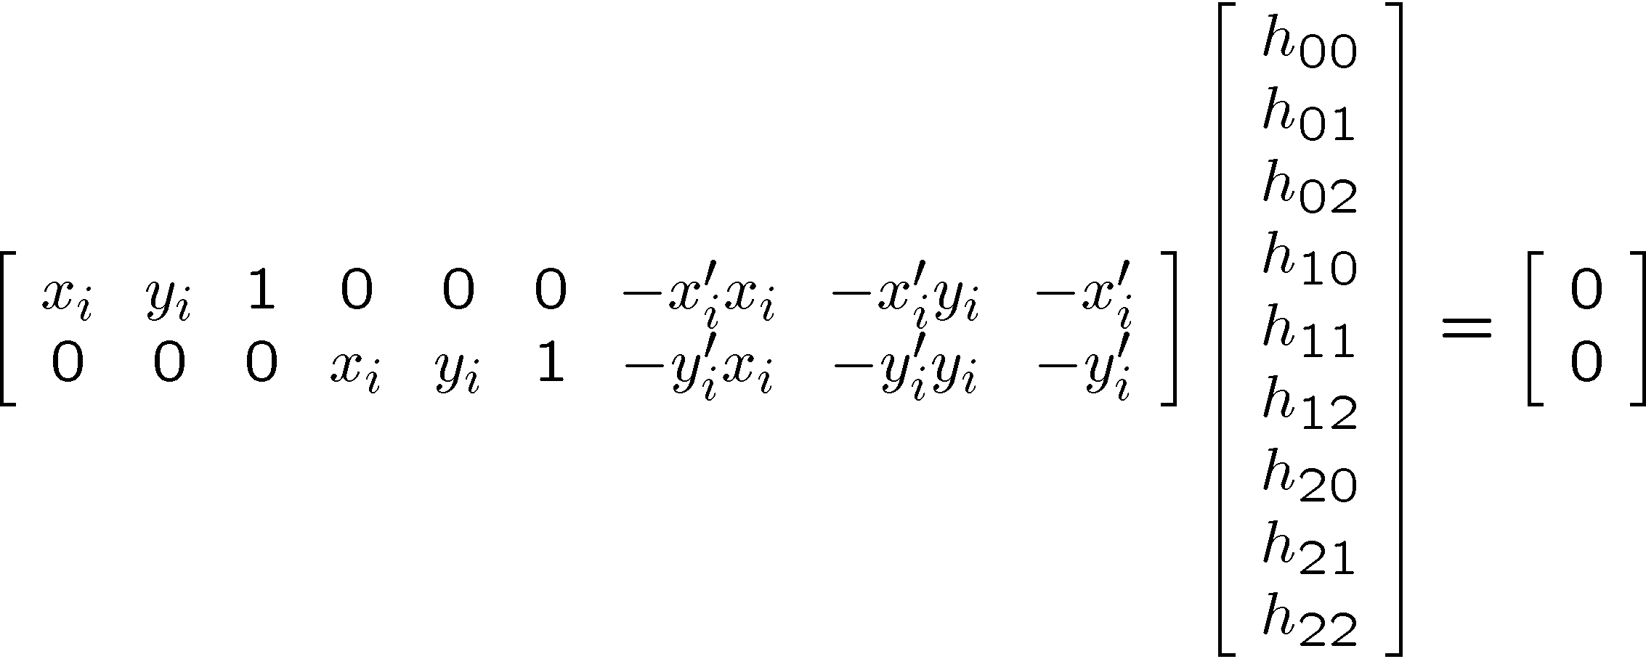
Solving for homographies

Slide 20
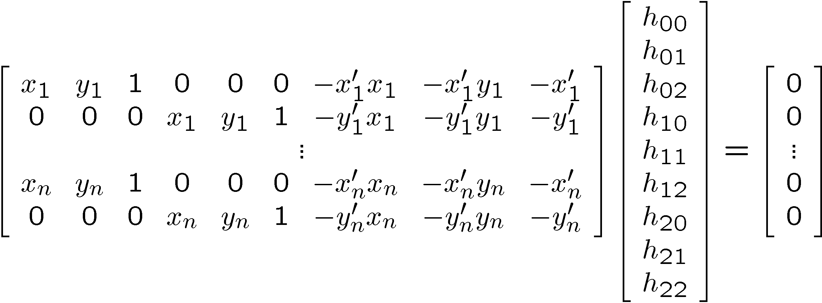
Solving for homographies
A
h
0
2n × 9
9
2n
Linear least squares
Since h is only defined up to scale, solve for unit vector ĥ
Minimize
Solution: ĥ = eigenvector of A^{T}A with smallest eigenvalue
Works with 4 or more points

Slide 21
Inhomogeneous solution
Since h can only be computed up to scale, impose constraint pick h_{j}=1, e.g. h₉=1, and solve for 8‐vector
⎡
0 0 0 − x_{i}w_{i} ' − y_{i}w_{i} ' − w_{i}w_{i} ' x_{i} y_{i} ' y_{i} y_{i} '⎤~ ⎛− w_{i} y_{i} '⎞
0 0 0 x x ' y x '^{⎥h = ⎜} w x ' ⎟
⎢x w ' y w ' w w '
i i ⎦ ⎝ i i ⎠
⎣ i i
i i i i
i i
Can be solved using linear least‐squares
However, if h₉=0 this approach fails Also poor results if h₉ close to zero Therefore, not recommended

Slide 22
Feature matching
descriptors for left image feature points
descriptors for right image feature points
?

Slide 23
Strategies to match images robustly
Working with individual features: For each feature point, find most similar point in other image (SIFT distance)
Reject ambiguous matches where there are too many similar points
Working with all the features: Given some good feature matches, look for possible homographies relating the two images
Reject homographies that don’t have many feature matches.
2

Slide 24
(a) Feature-space outlier rejection
Let’s not match all features, but only these that have “similar enough” matches?
How can we do it?
SSD(patch1,patch2) < threshold
How to set threshold?
Not so easy.

Slide 25
Feature-space outlier rejection
A better way [Lowe, 1999]:
1-NN: SSD of the closest match
2-NN: SSD of the second-closest match
Look at how much better 1-NN is than 2-NN, e.g. 1-NN/2-NN
That is, is our best match so much better than the rest?

Slide 26
RAndom SAmple Consensus
Select one match, count inliers

Slide 27
RANSAC for estimating homography
RANSAC loop:
Select four feature pairs (at random) Compute homography H (exact)
Compute inliers where ||p_{i}’, H p_{i}|| < ε
Keep largest set of inliers
Re-compute least-squares H estimate using all of the inliers

Slide 28
RANSAC
red:
rejected by 2nd nearest neighbor criterion blue:
Ransac outliers yellow:
inliers

Slide 29
Robustness
Proportion of inliers in our pairs is G (for
“good”)
Our model needs P pairs
P=4 for homography
Probability that we pick P inliers?
G^{P}
Probability that after N RANSAC iterations we have not picked a set of inliers?
– (1-G^{P})^{N}
3

Slide 30
Robustness: example
Matlab: p=4; x=0.5; n=1000; (1-x^p)^n
Proportion of inliers G=0.5
Probability that we pick P=4 inliers?
– 0.5⁴=0.0625 (6% chance)
Probability that we have not picked a set of inliers?
N=100 iterations:
(1-0.5⁴)¹⁰⁰=0.00157 (1 chance in 600)
N=1000 iterations:
1 chance in 1e28

Slide 31
Robustness: example
Proportion of inliers G=0.3
Probability that we pick P=4 inliers?
– 0.3⁴=0.0081 (0.8% chance)
Probability that we have not picked a set of inliers?
N=100 iterations:
(1-0.3⁴)¹⁰⁰=0.44 (1 chance in 2)
N=1000 iterations:
1 chance in 3400

Slide 32
Robustness: example
Proportion of inliers G=0.1
Probability that we pick P=4 inliers?
– 0.1⁴=0.0001 (0.01% chances, 1 in 10,000)
Probability that we have not picked a set of inliers?
– N=100 iterations: (1-0.1⁴)¹⁰⁰=0.99
– N=1000 iterations: 90%
– N=10,000: 36%
– N=100,000: 1 in 22,000

Slide 33
Robustness: conclusions
Effect of number of parameters of model/ number of necessary pairs
Bad exponential
Effect of percentage of inliers
Base of the exponential
Effect of number of iterations
Good exponential
47

Slide 34
RANSAC recap
For fitting a model with low number P of parameters (8 for homographies)
Loop
Select P random data points
Fit model
Count inliers
(other data points well fit by this model)
Keep model with largest number of inliers
48

Slide 35
RANSAC for Homography

Slide 36
RANSAC for Homography

Slide 37
RANSAC for Homography

Slide 38
Camera pose estimation
Assume all points lie in one plane with Z=0:
–r₁ and r₂ are unit vectors ⇨ find lambda
–Use this to compute t
–Rotation matrices are orthogonal ⇨ find r3

Slide 39
Problems
Problem:
The vectors r₁ and r₂ might not yield the same lambda
Solution:
Use the average value
Problem:
The estimated rotation matrix might not be orthogonal
Solution: orthogonalize R’
Obtain SVD ⇨ R’=UWV^{T}
Set singular values to 1 ⇨ R=UV^{T}

Slide 42
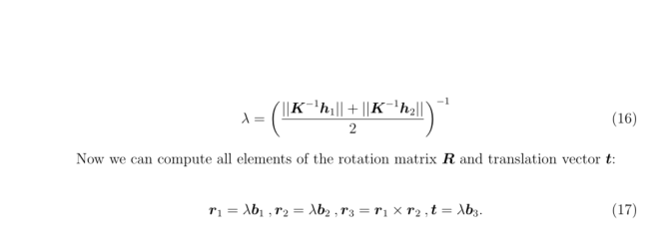
Estimate lambda as average length

